Slide 1


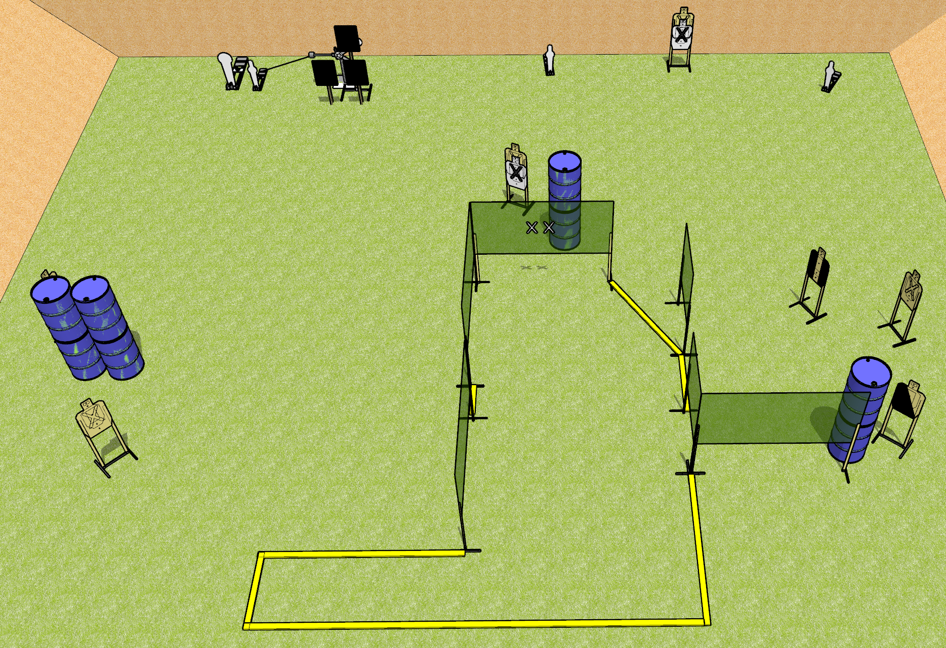
 | Dothan Gun Club – USPSA Match Crushin It Course Designer : Keanu Sy
Round Count 20 rounds 7 USPSA 1 colt, 3 mini, 2 plates
Equipment List 10 wall feet Red stitch + hard cover plates and stands (x3) 1 tux, 2 left diag, 6 targets (4 + 2NS)

Slide 2
Crushin It
Written Stage Briefing
Scoring: Comstock
Rounds: 20
Targets: 7 USPSA, 6 steel
Handgun start position: hands touching upper marks. Handgun is loaded and holstered.
PCC start position: muzzle touching lower mark, stock on belt. Carbine is loaded, safety on.
Stage Procedure: on the audible start signal, engage targets as they become available from within the shooting area. The swinger is activated by P2 and remains visible at rest.

